Slide 1

Duty Matrix
By- Utkarsh Sahu, Akshat Verma

Slide 2
Introduction
Police departments traditionally manage duty schedules, leave approvals, and shift coordination through manual processes, leading to delays, miscommunication, and lack of accountability across hierarchical roles. DutyMatrix addresses this problem by providing a centralized, role‑based digital platform that automates leave workflows, shift management, and approvals while enforcing proper authority levels. With secure authentication and real‑time notifications, the system ensures transparency, faster decision‑making, and efficient workforce management.

Slide 3
Technology Used
Spring Boot (Backend): Spring Boot is used to build the backend of DutyMatrix because it simplifies application development by reducing configuration and boilerplate code. It provides a robust framework for building secure REST APIs, handling business logic, role-based authorization using JWT, and managing database operations through JPA and Hibernate. This helps in creating a scalable, secure, and maintainable backend system.
React JS (Frontend): React is used for the frontend to build a fast, interactive, and user-friendly interface. It allows the application to update data dynamically without reloading pages, which improves user experience. Using components, React Router, and Redux,Context API, the frontend efficiently handles role-based dashboards, protected routes, and seamless communication with the backend APIs.
MySQL (Database): MySQL is used as the relational database to store structured data such as users, roles, duties, leaves, and shifts, ensuring data integrity and reliable relationships between entities.
Node.js (Notification Microservice): A separate Node.js microservice is used for handling notifications. This keeps the notification system independent, scalable, and fault-tolerant without affecting core business operations

Slide 4

Use Classes
Commissioner
Station Incharge
Police Officer
highest level of access in the system
acts as a supervisory role at the station level
the primary users of the system

Slide 5
Objectives
Automate police duty, leave, and shift management to eliminate manual paperwork, delays, and miscommunication.
Enforce strict role-based hierarchy (Police Officer → Station Incharge → Commissioner) so every action follows official approval rules.
Ensure smooth operational continuity by managing shifts, leave approvals, and shift swaps without disrupting station duties.
Provide command-level oversight to senior officers for monitoring activities across stations with transparency and accountability.
Improve coordination through real-time notifications so all stakeholders stay informed about approvals, rejections, and assignments.

Slide 6
POLICE OFFICER MODULES
Leave Management – Apply for leave and track approval status
Shift View – View assigned duty shifts
Shift Swap – Request shift swap with another officer of the same station
FIR Management – Create and update FIRs assigned to them
Notifications – Receive alerts for leave status, shift assignments, and swap decisions

Slide 7
STATION INCHARGE MODULES
Leave Approval – Approve or reject leave requests from police officers
Shift Management – Create shifts and assign officers
Shift Swap Approval – Approve or reject shift swap requests
FIR Assignment – Assign investigating officers to FIRs
Station-Level Dashboard – Monitor duties, leaves, and FIRs within their station
Notifications – Get alerts for leave and swap requests

Slide 8
COMMISSIONER MODULES
Leave Oversight – Approve or auto-approve leave requests from Station Incharge
Global FIR View – View FIRs across all stations
Duty Oversight Dashboard – Monitor shifts, manpower, and activities system-wide
Policy-Level Control – Ensure rules and hierarchy are followed
Notifications – Receive important alerts from stations

Slide 9
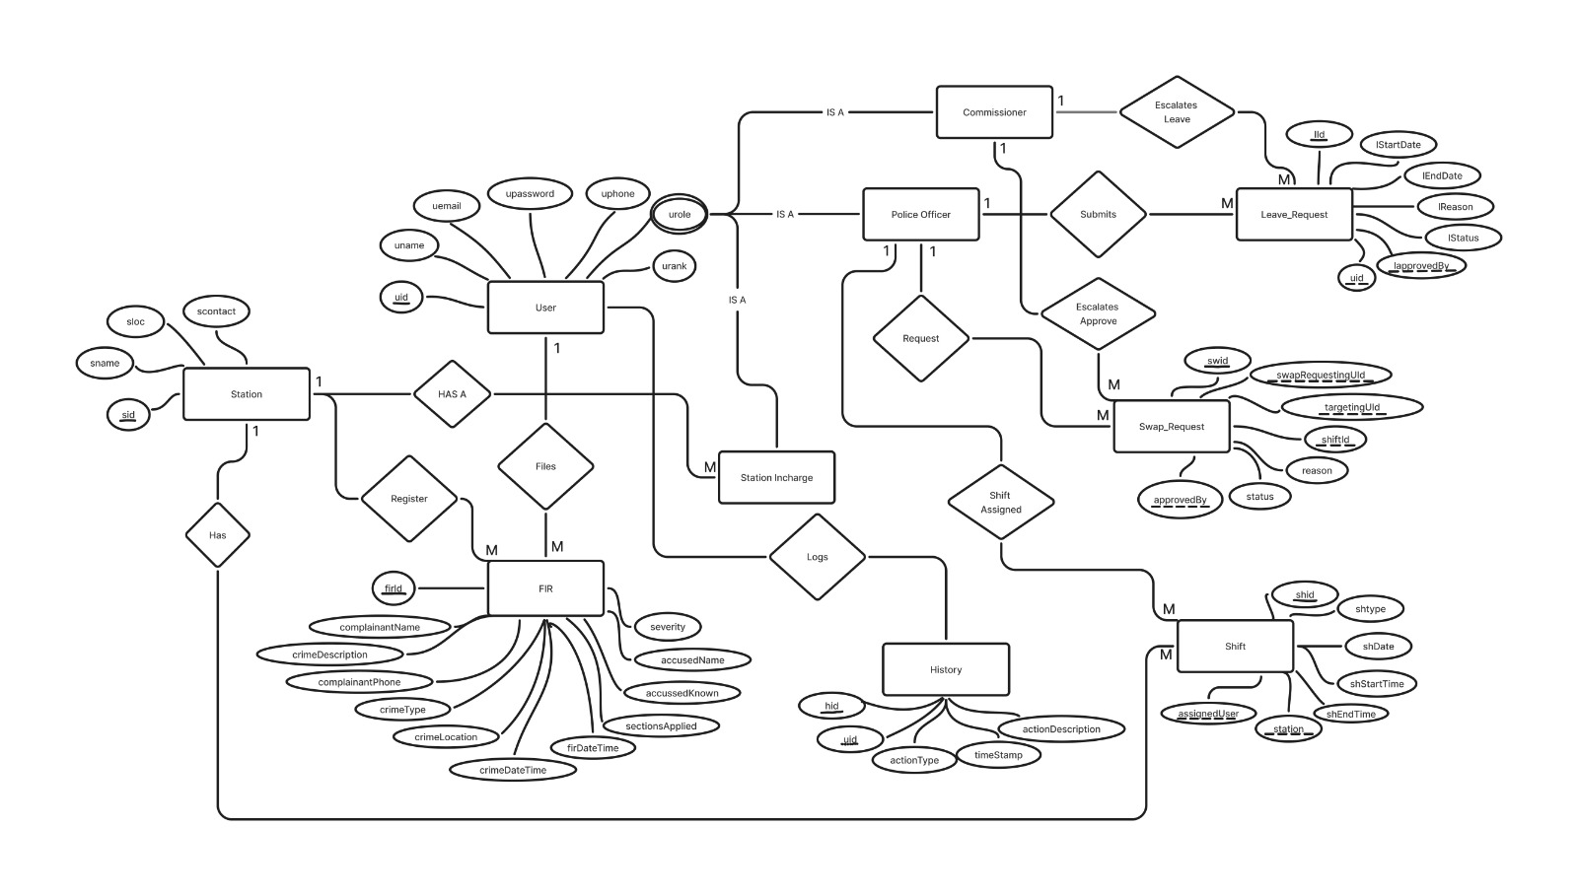
ER Diagram

Slide 10
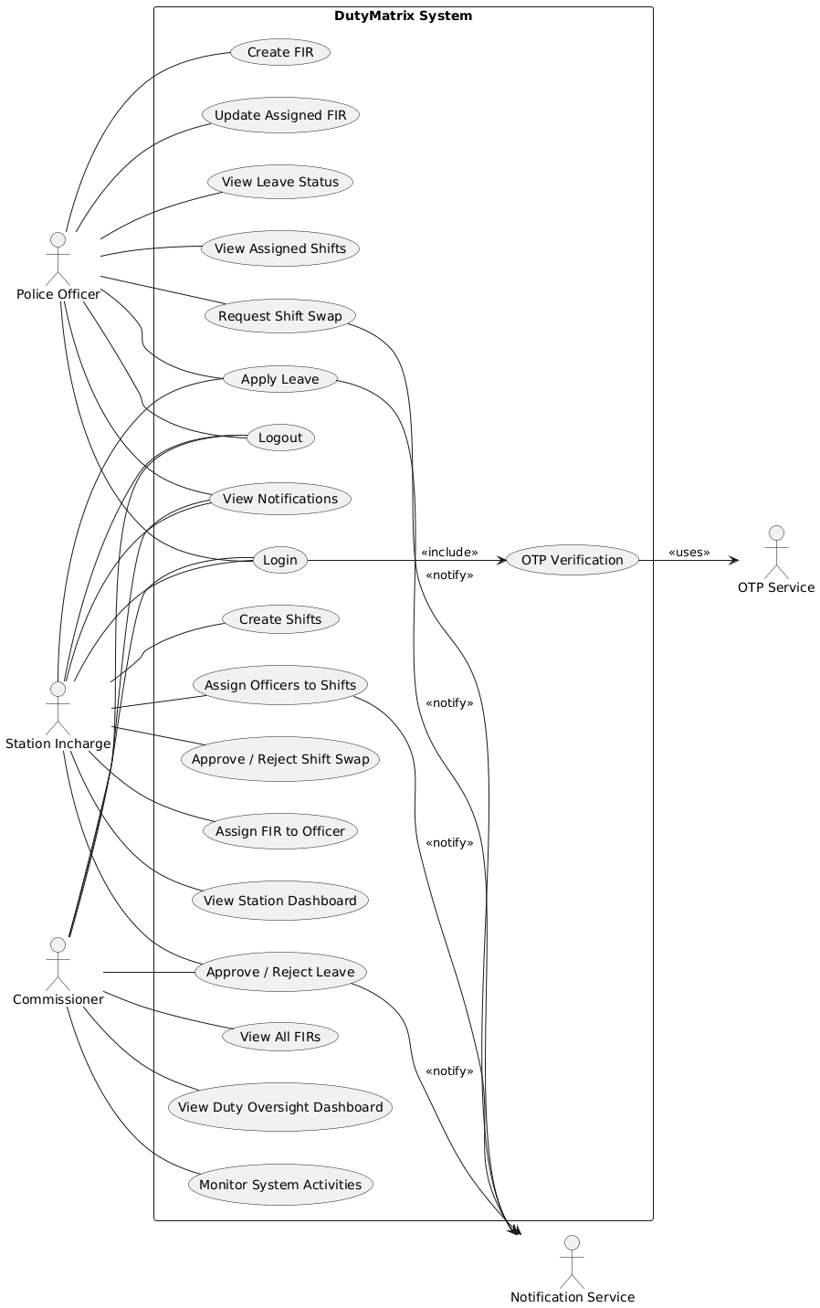

Slide 11
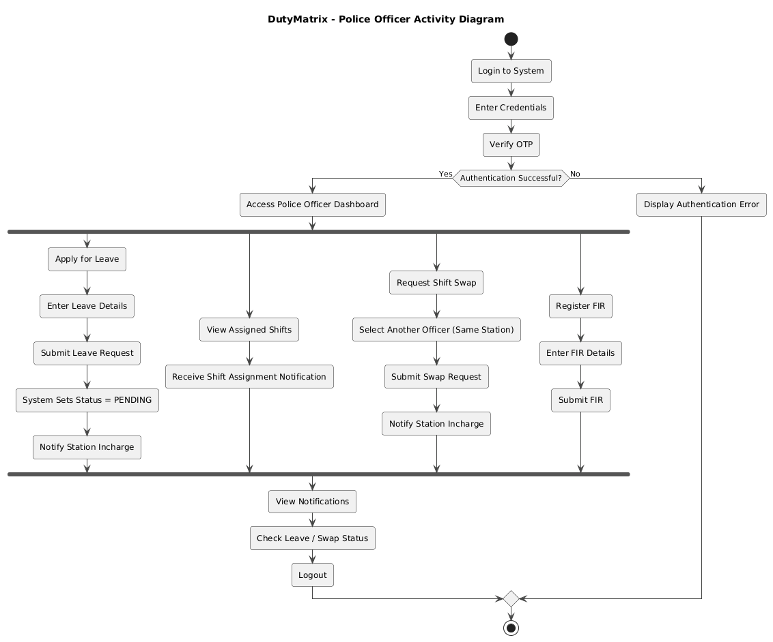

Slide 12
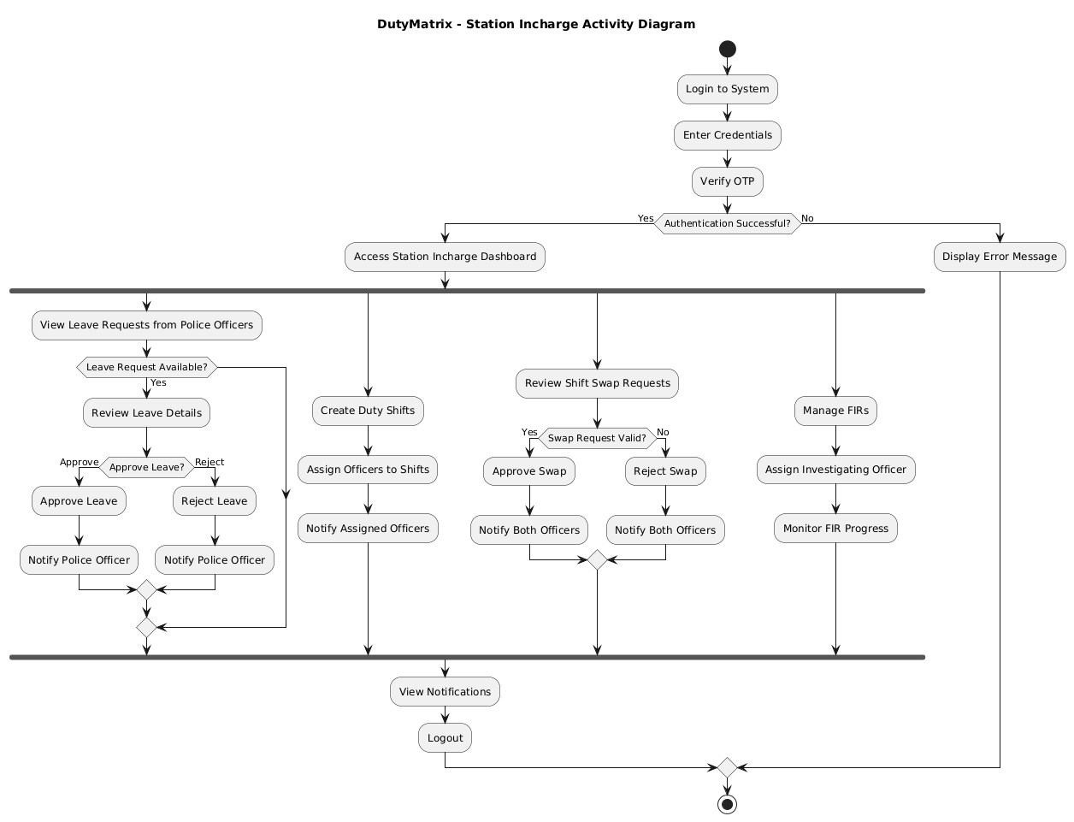

Slide 13
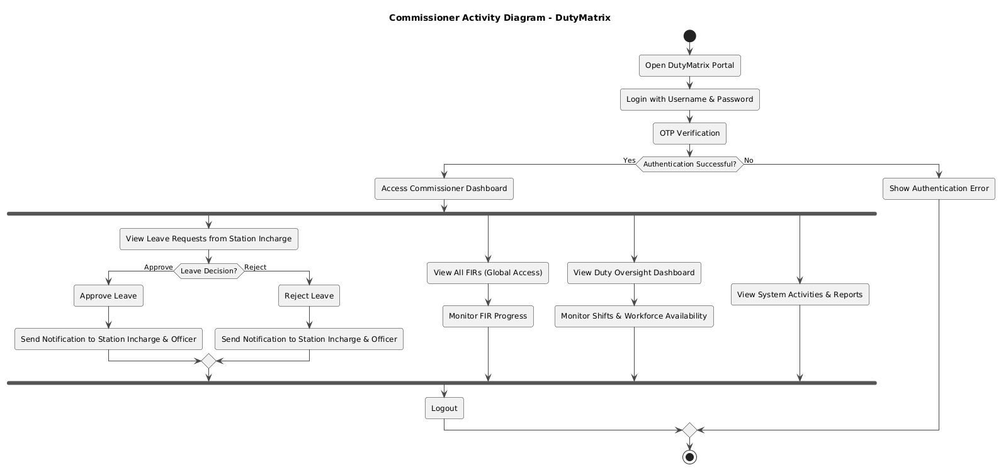

Slide 14
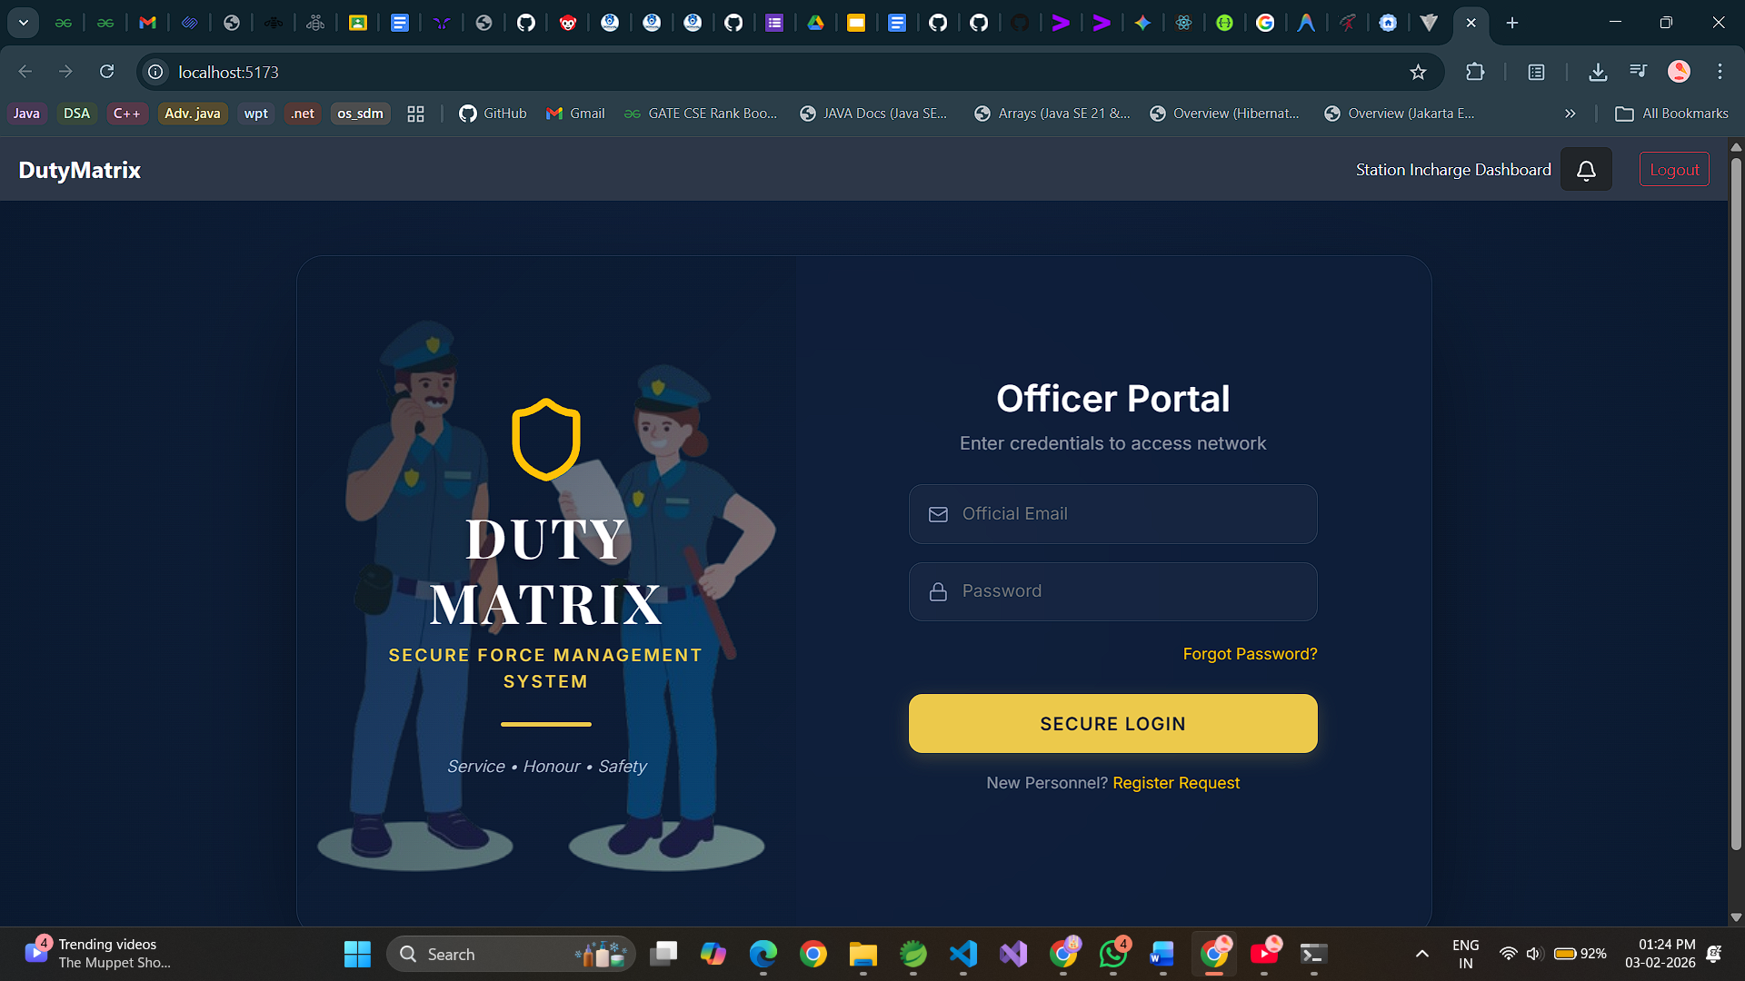

Slide 15
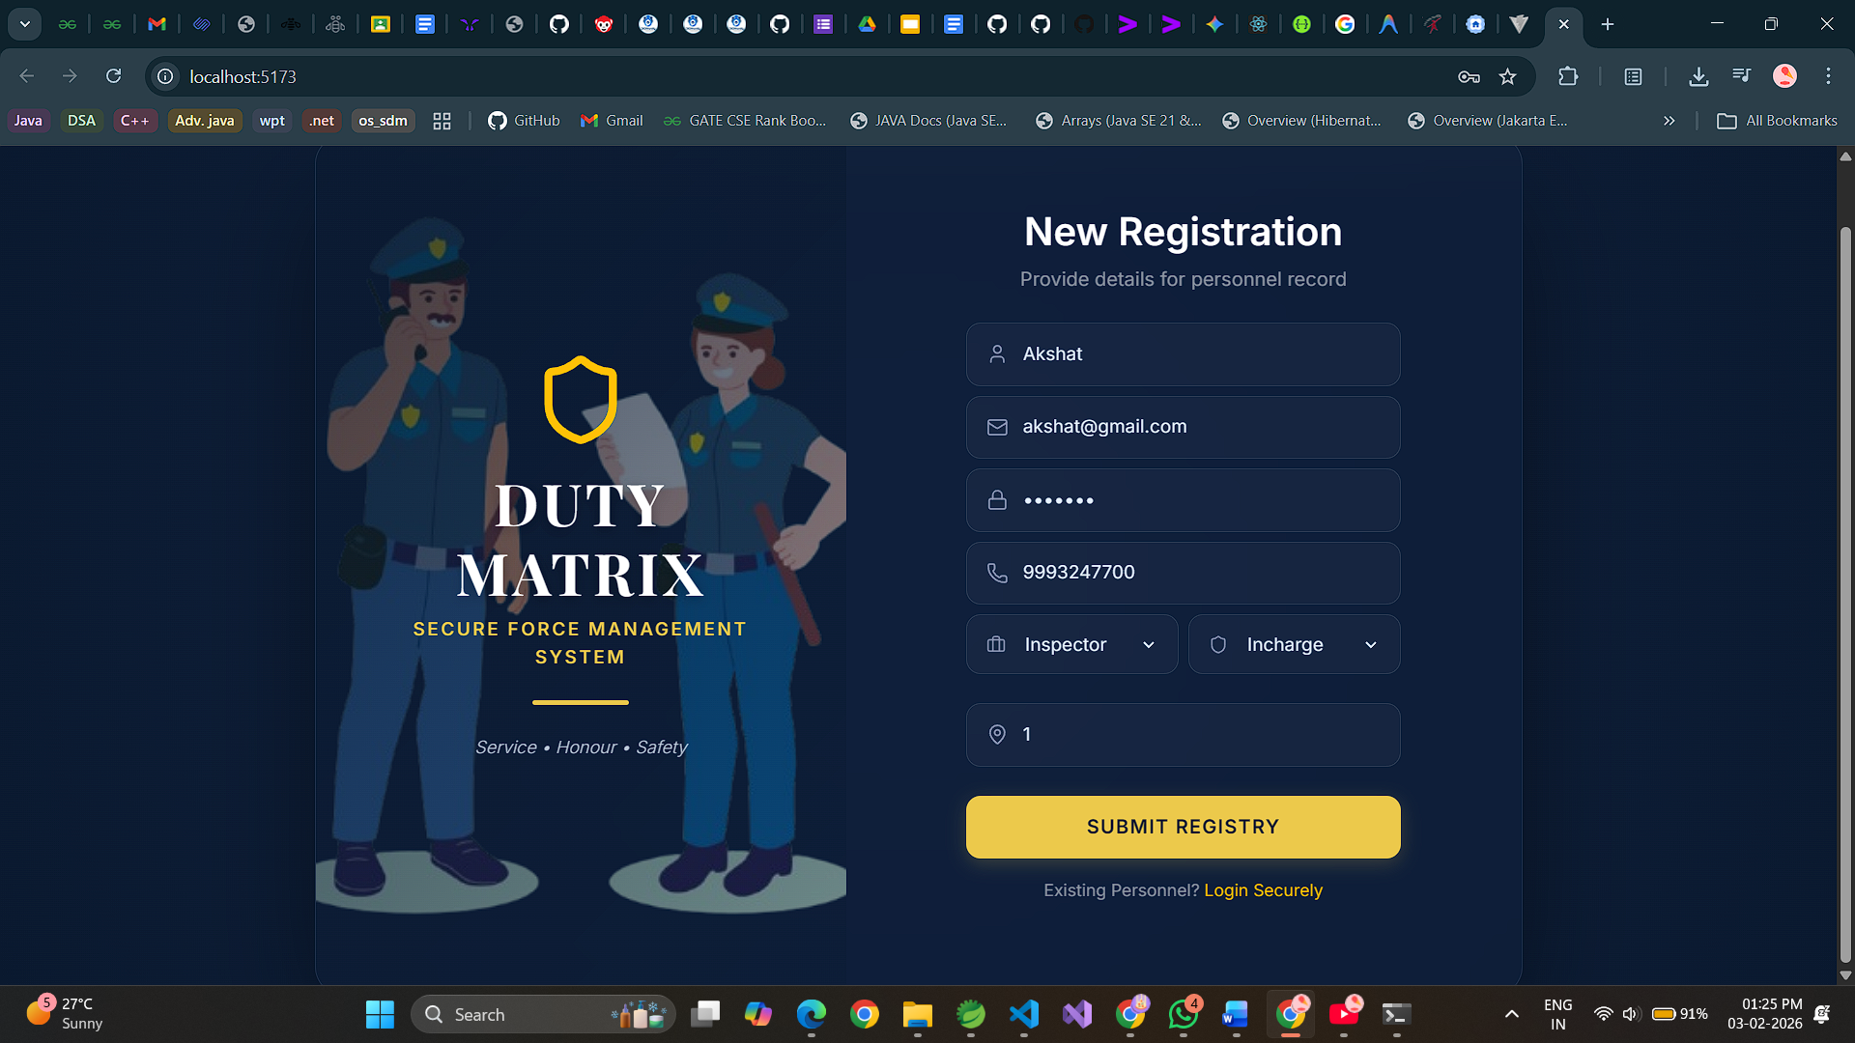

Slide 16
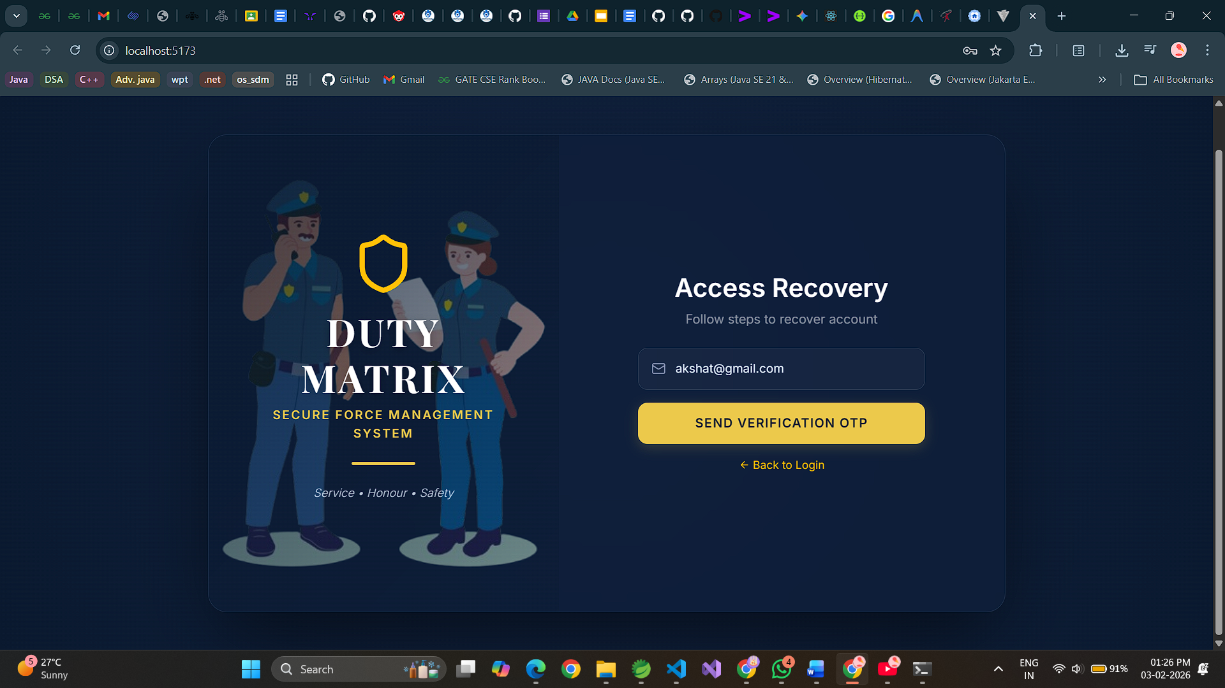

Slide 17
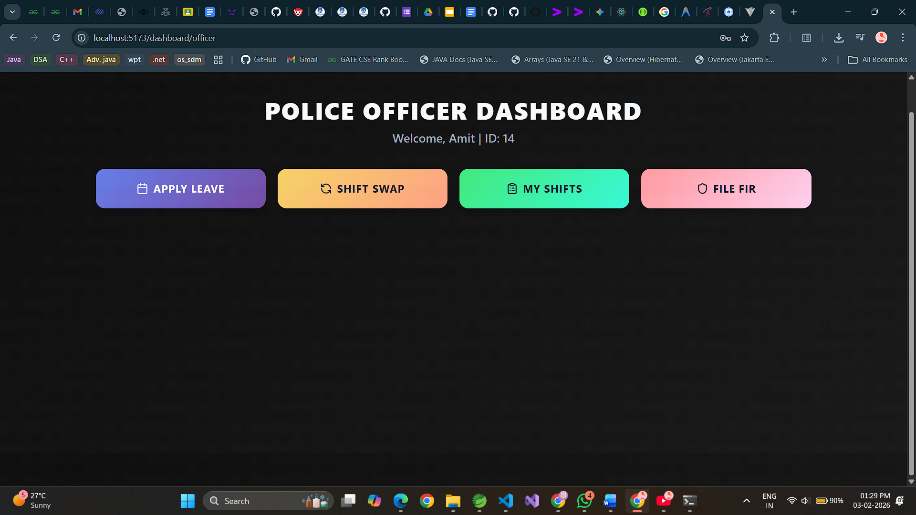

Slide 18
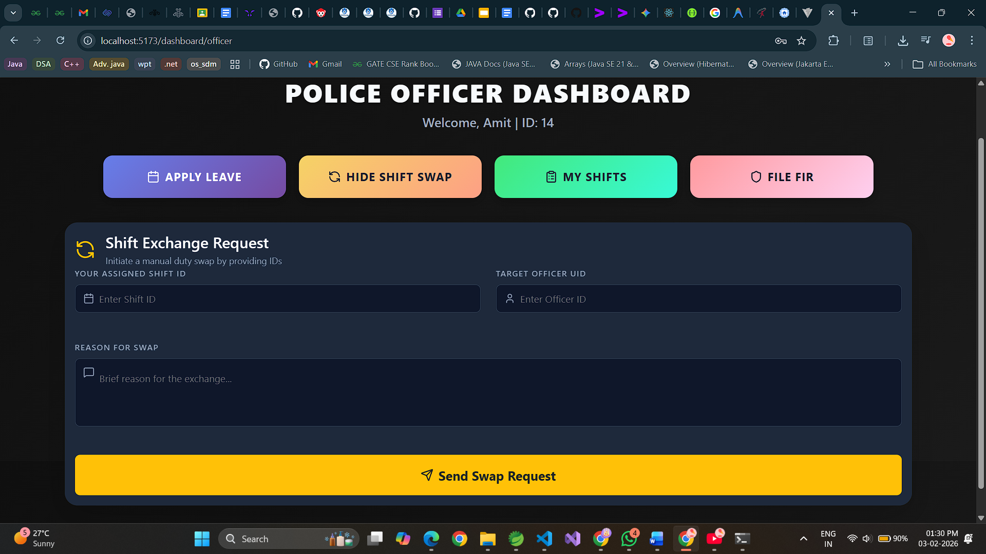

Slide 19
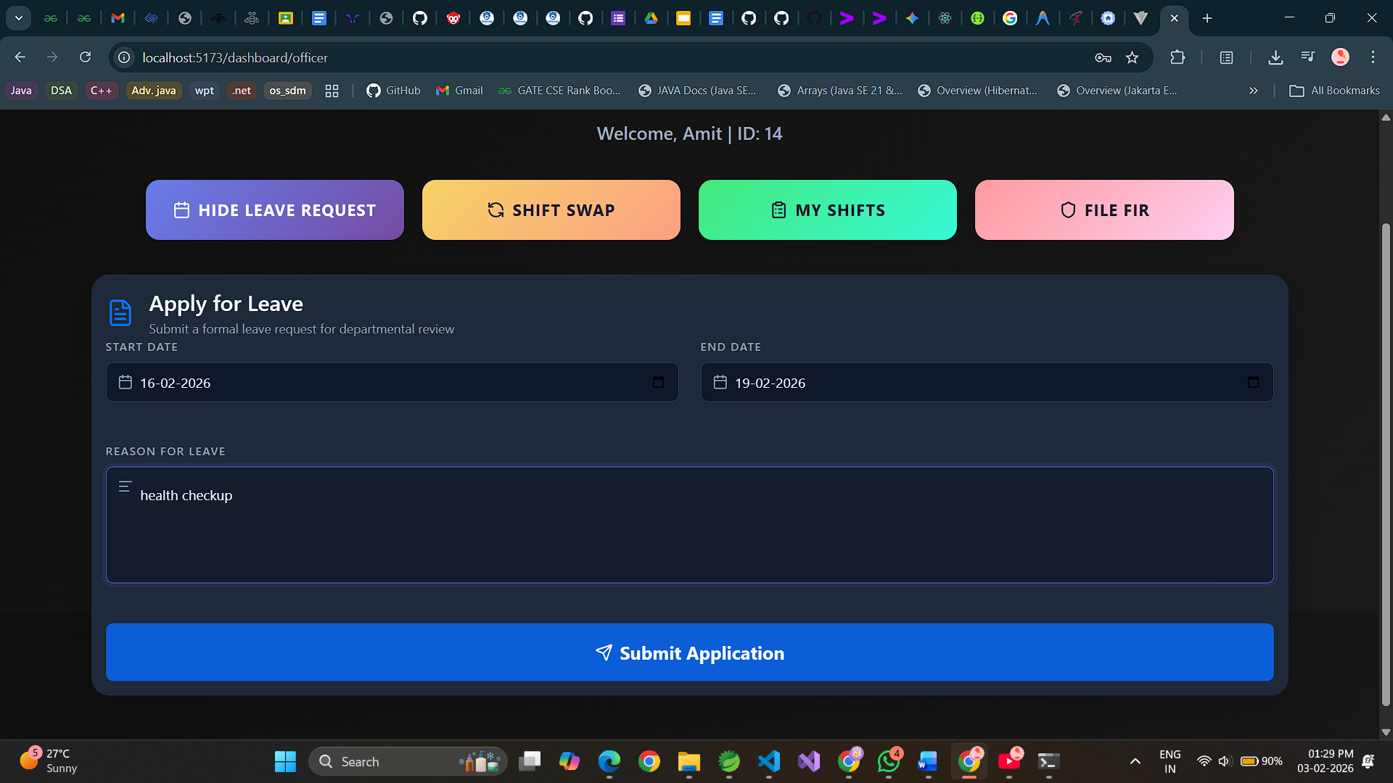

Slide 20
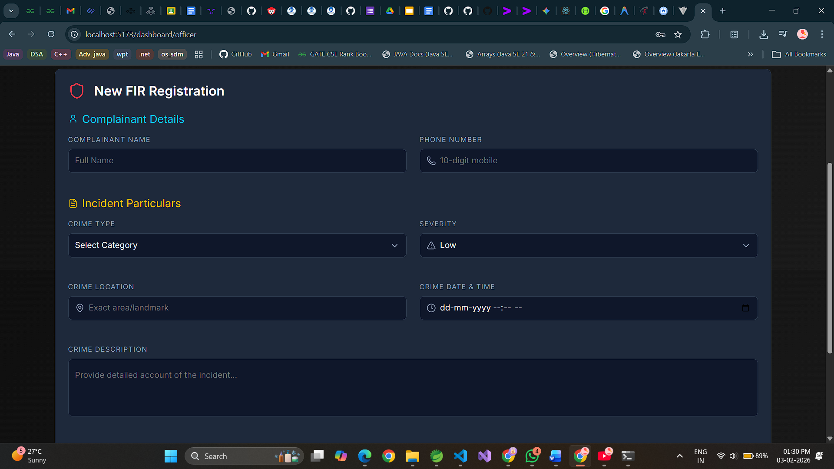

Slide 21
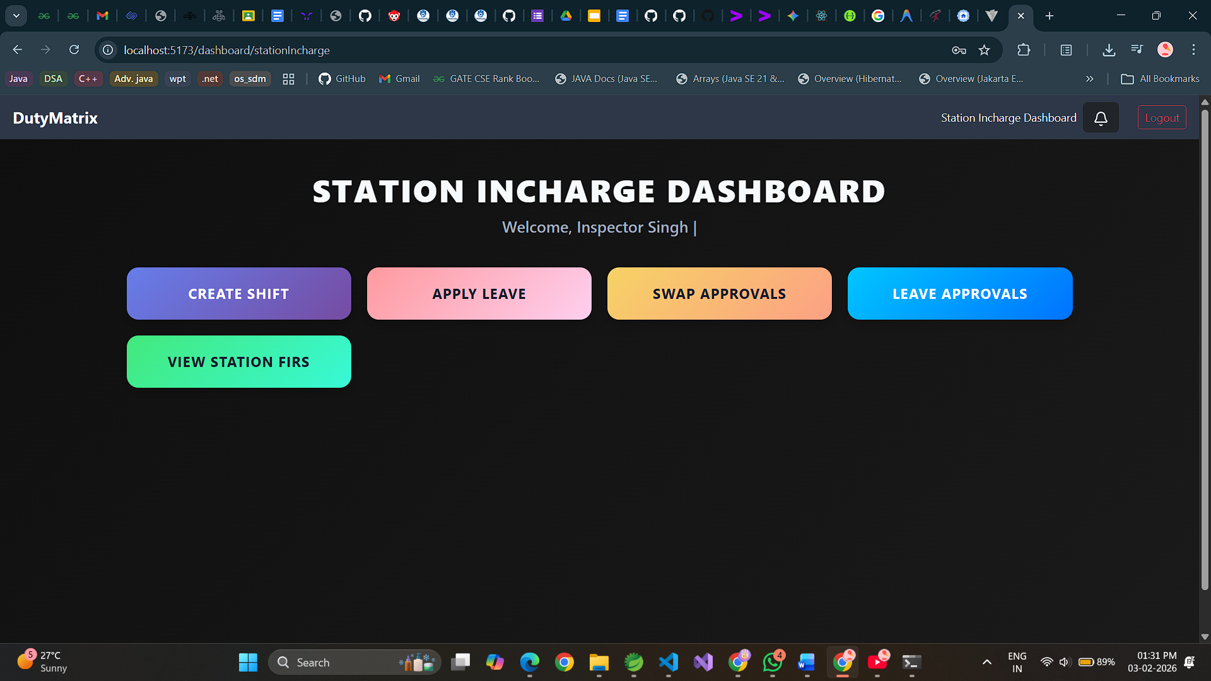

Slide 22
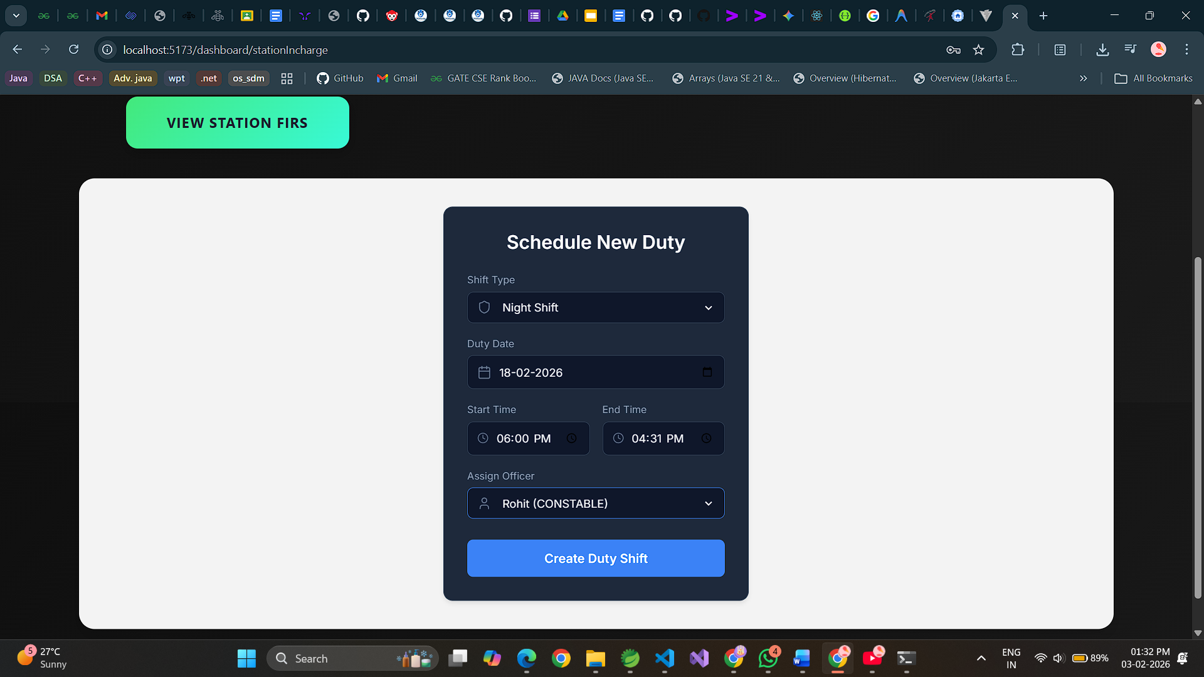

Slide 23
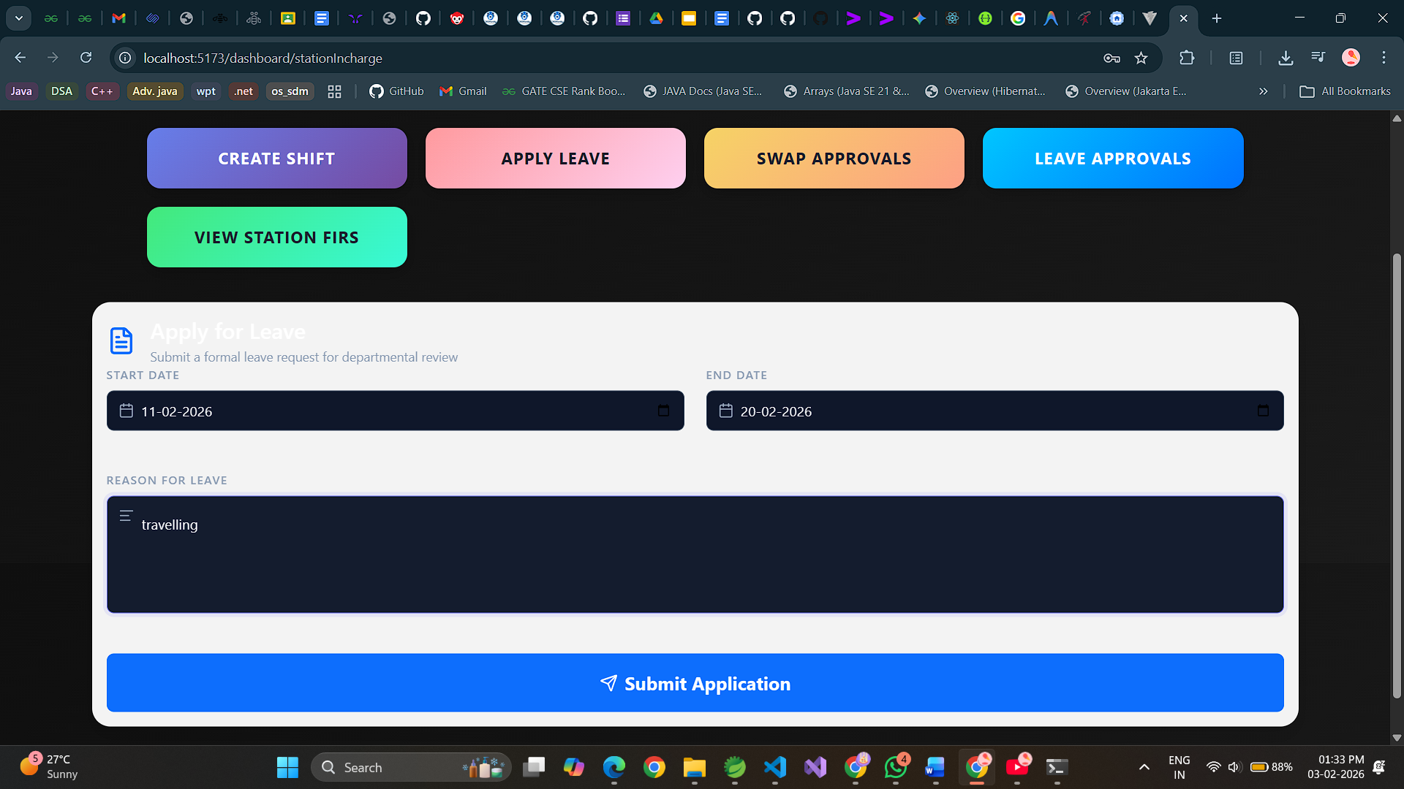

Slide 24
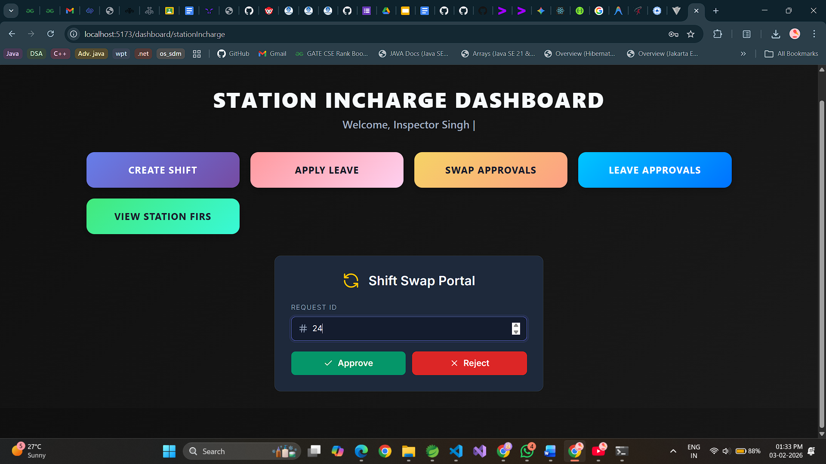

Slide 25
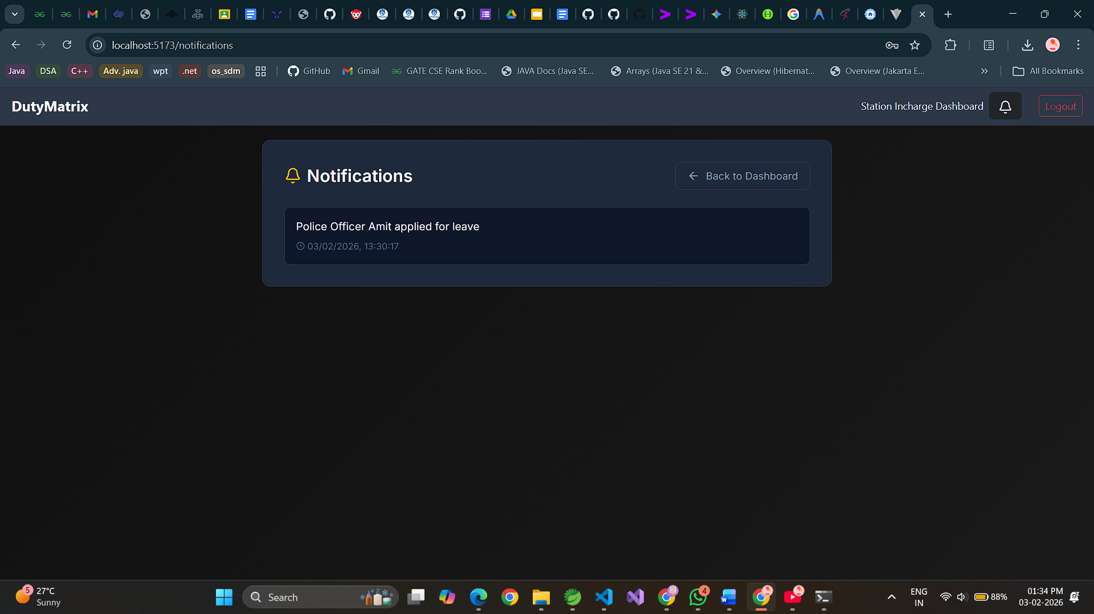

Slide 26
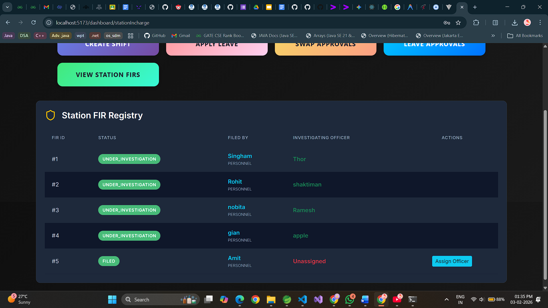

Slide 27
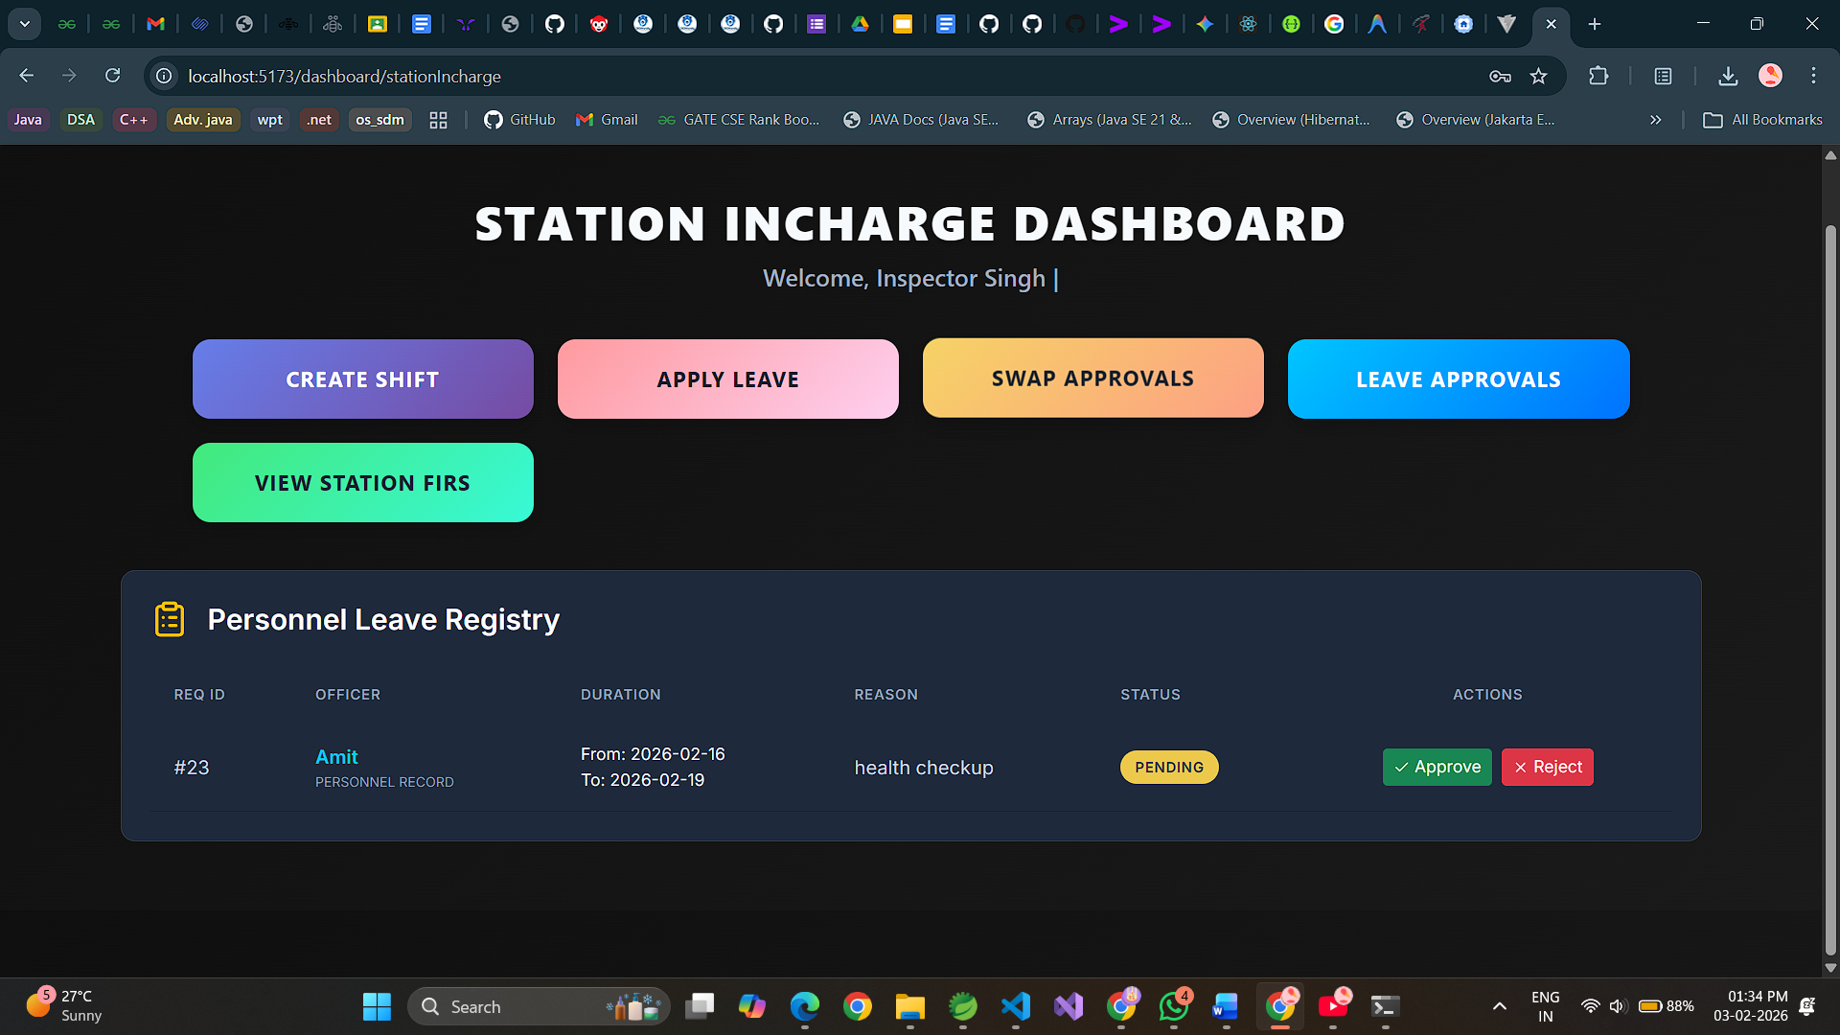

Slide 28
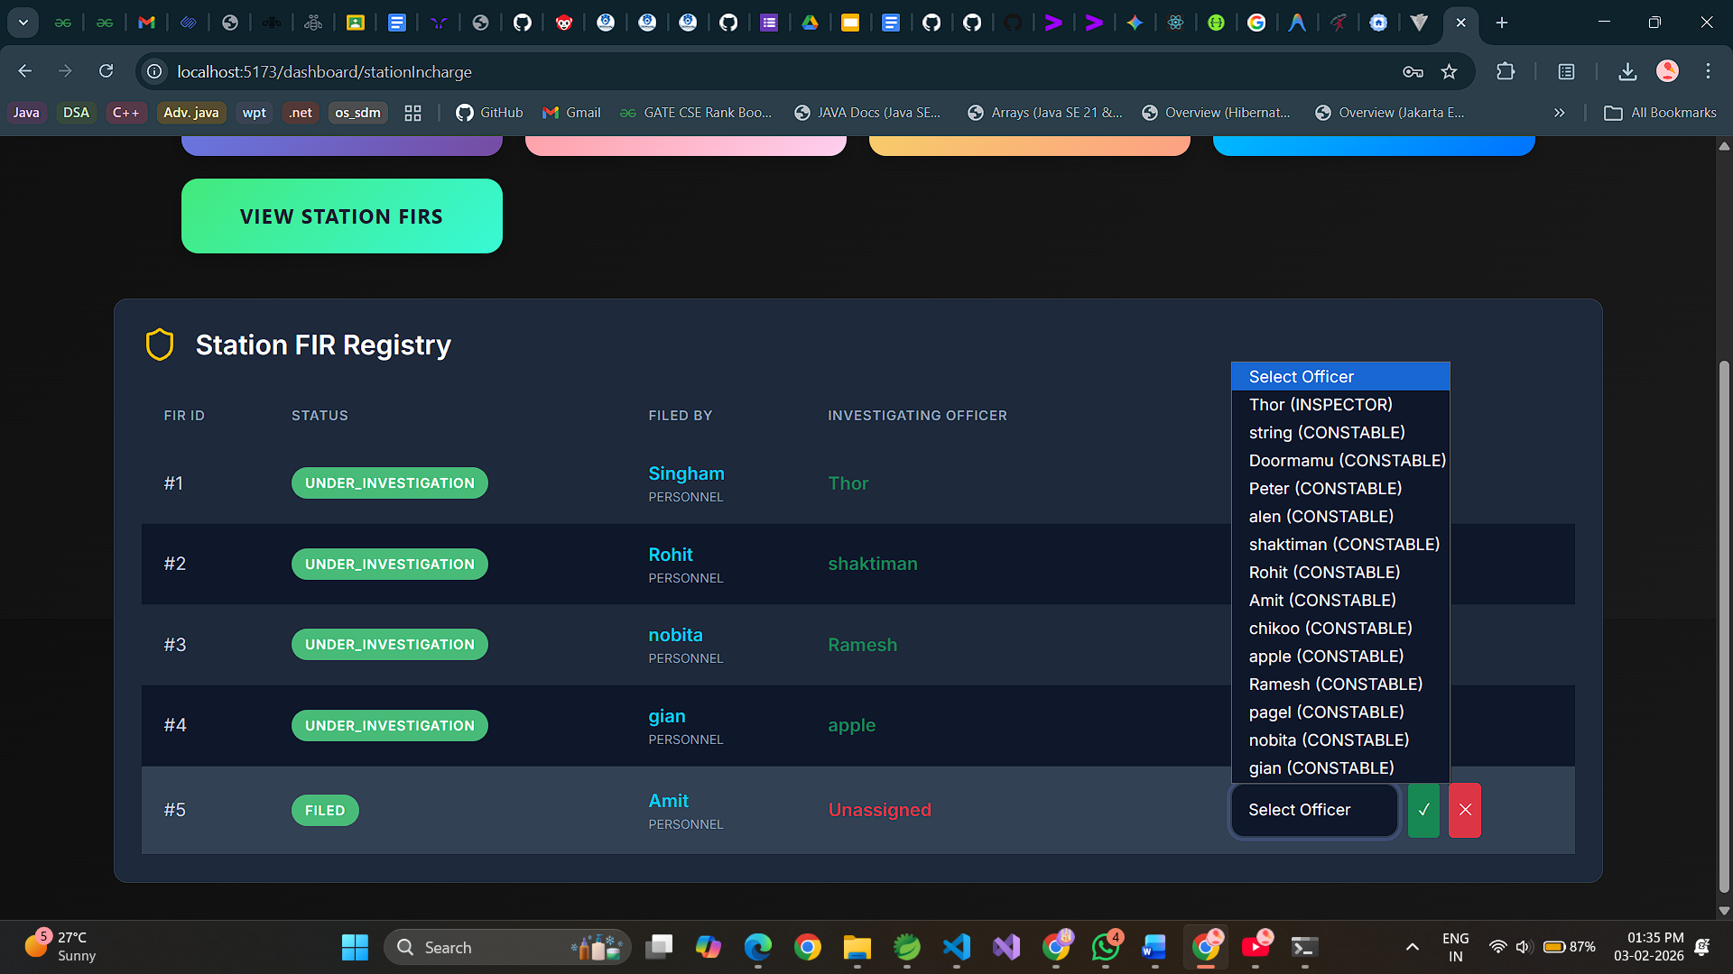

Slide 29
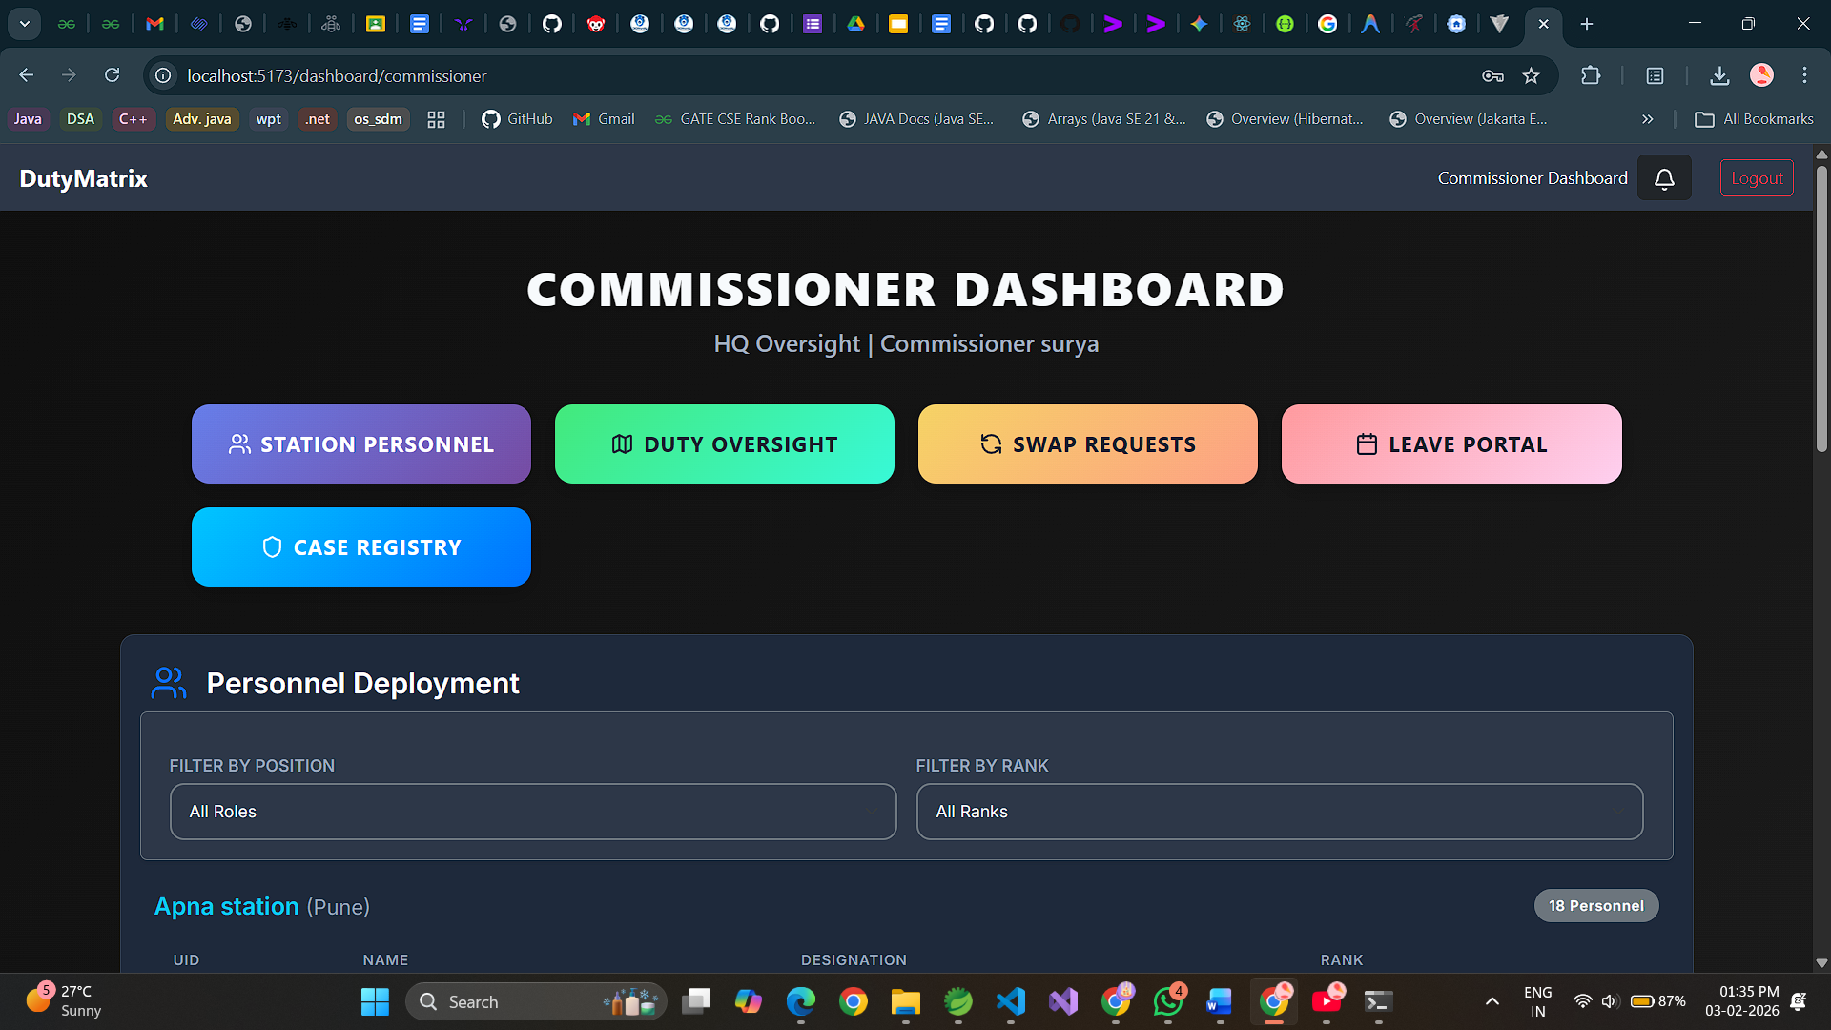

Slide 30
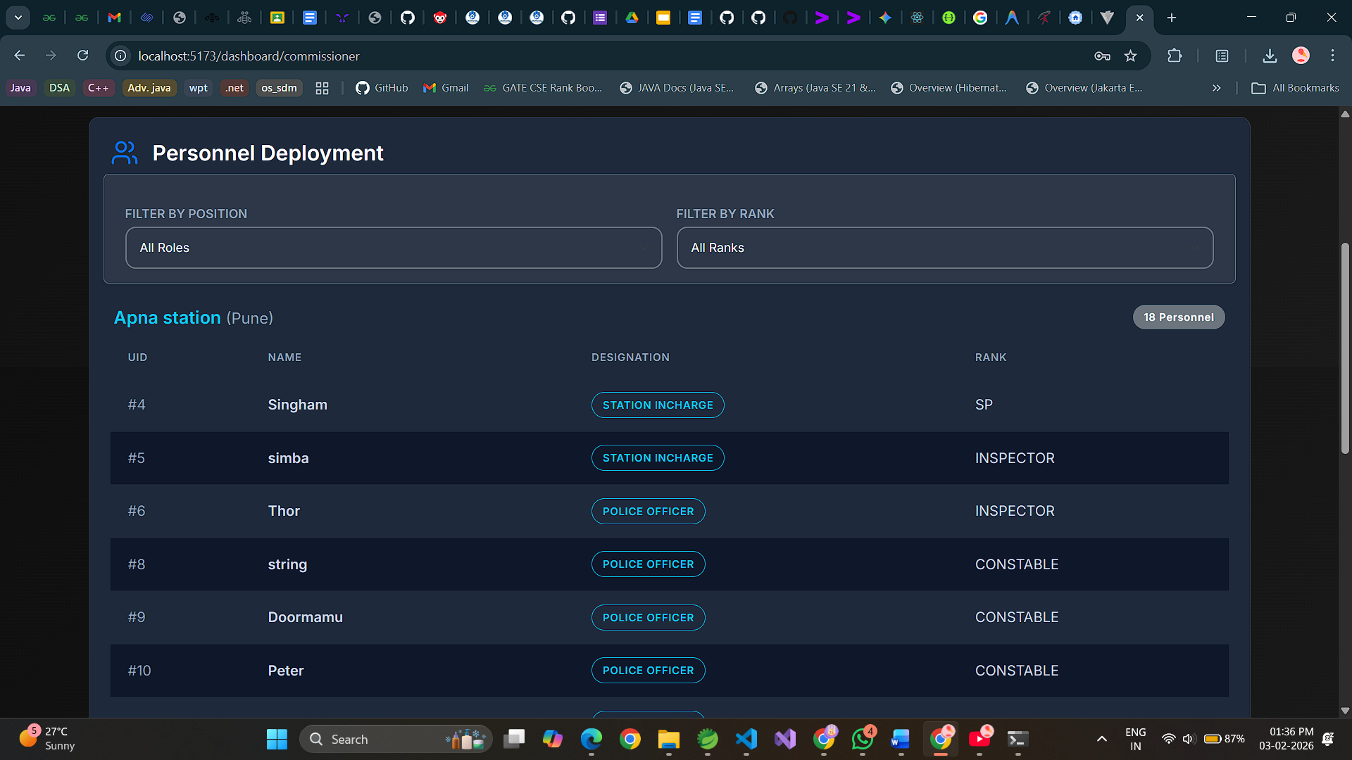

Slide 31
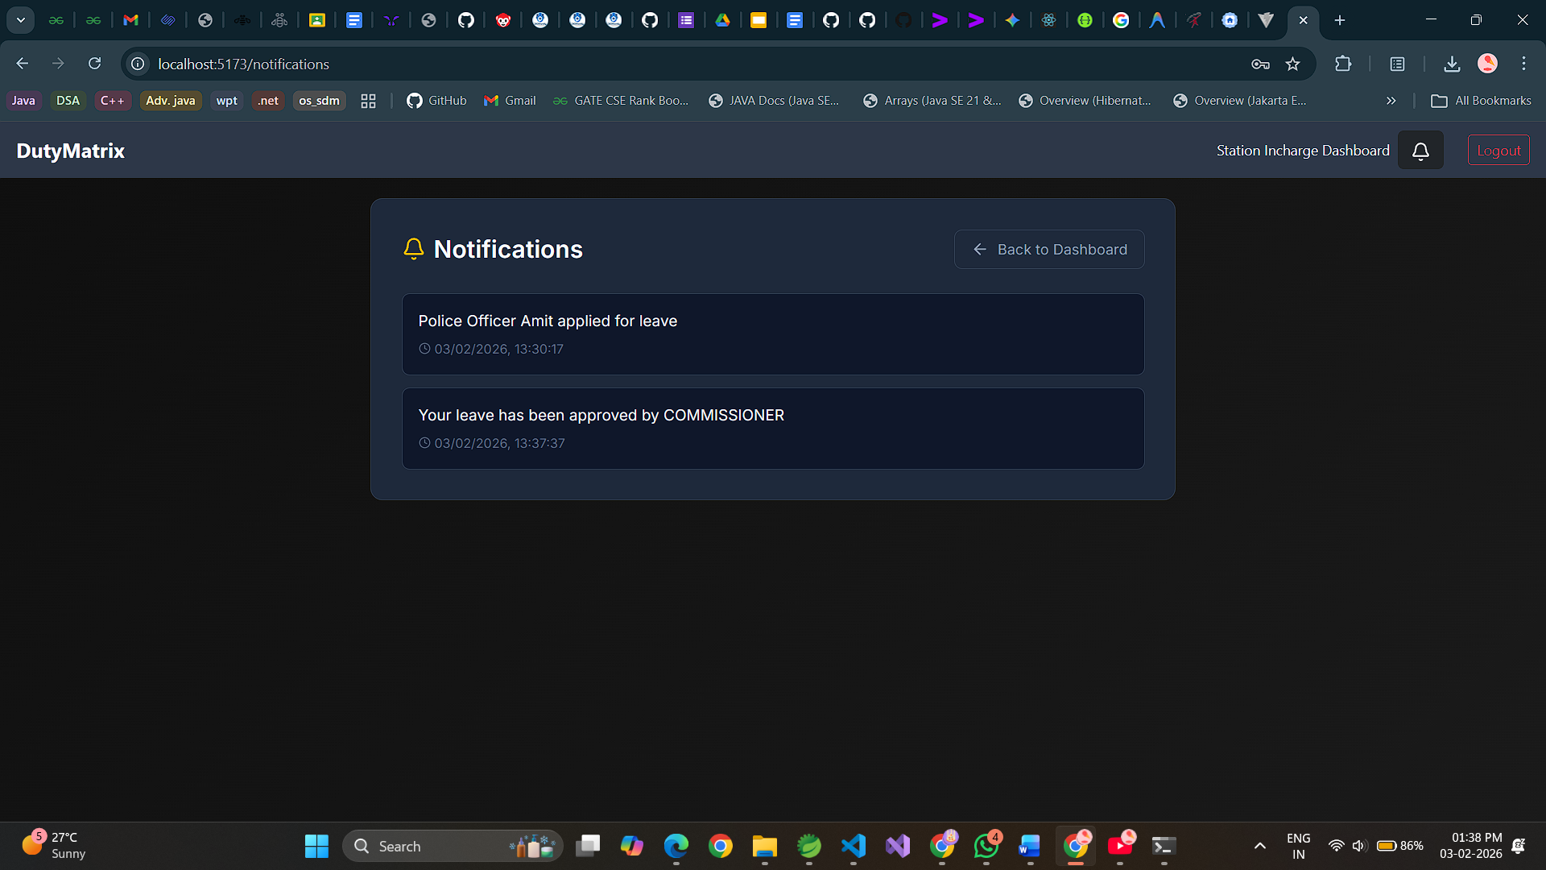

Slide 32
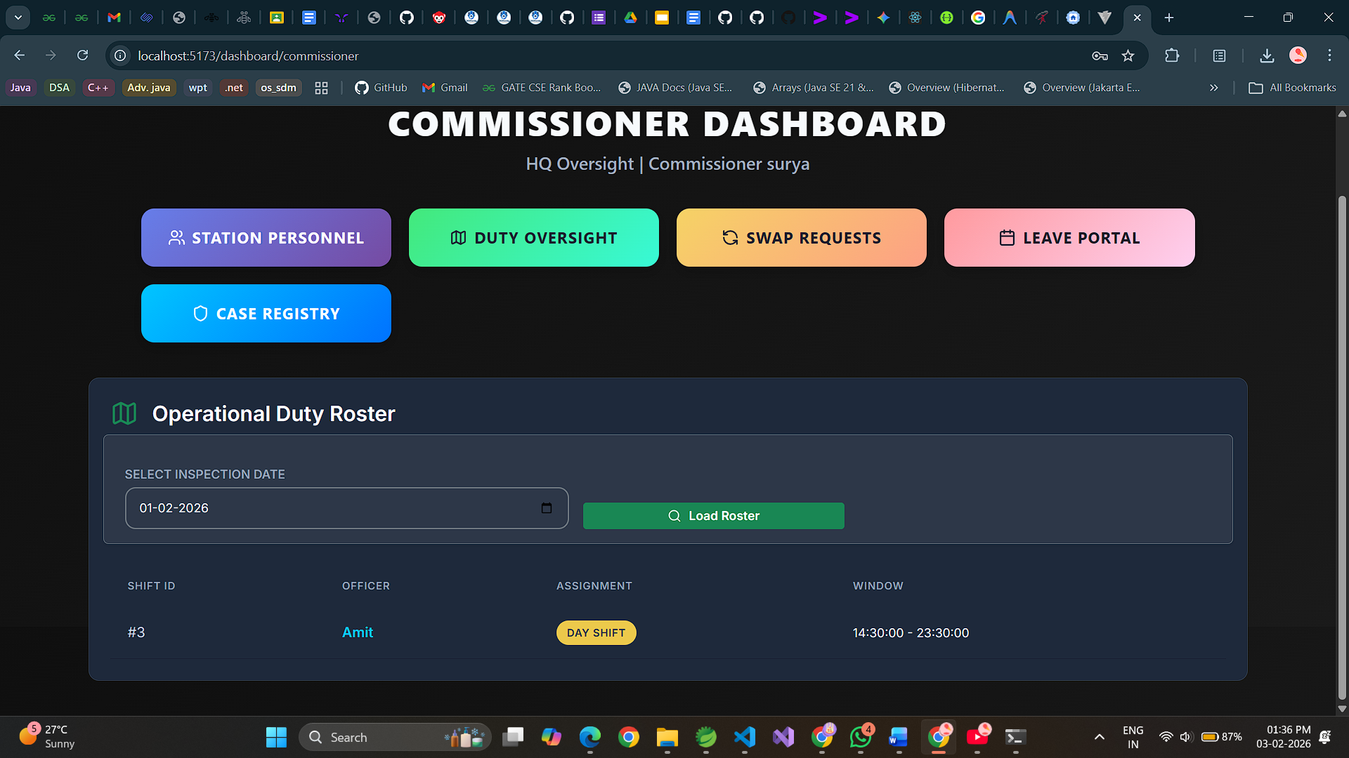

Slide 33
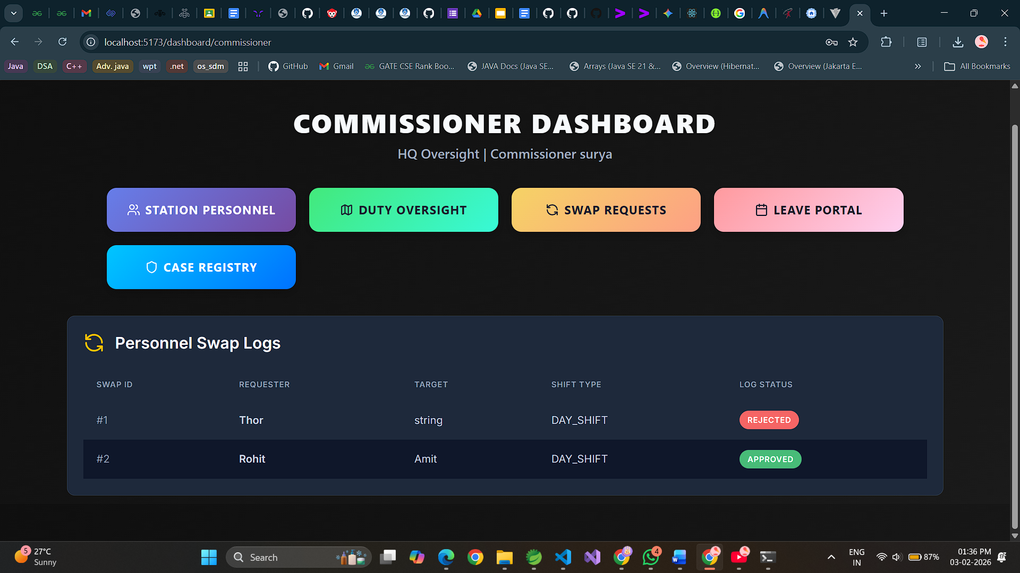

Slide 34
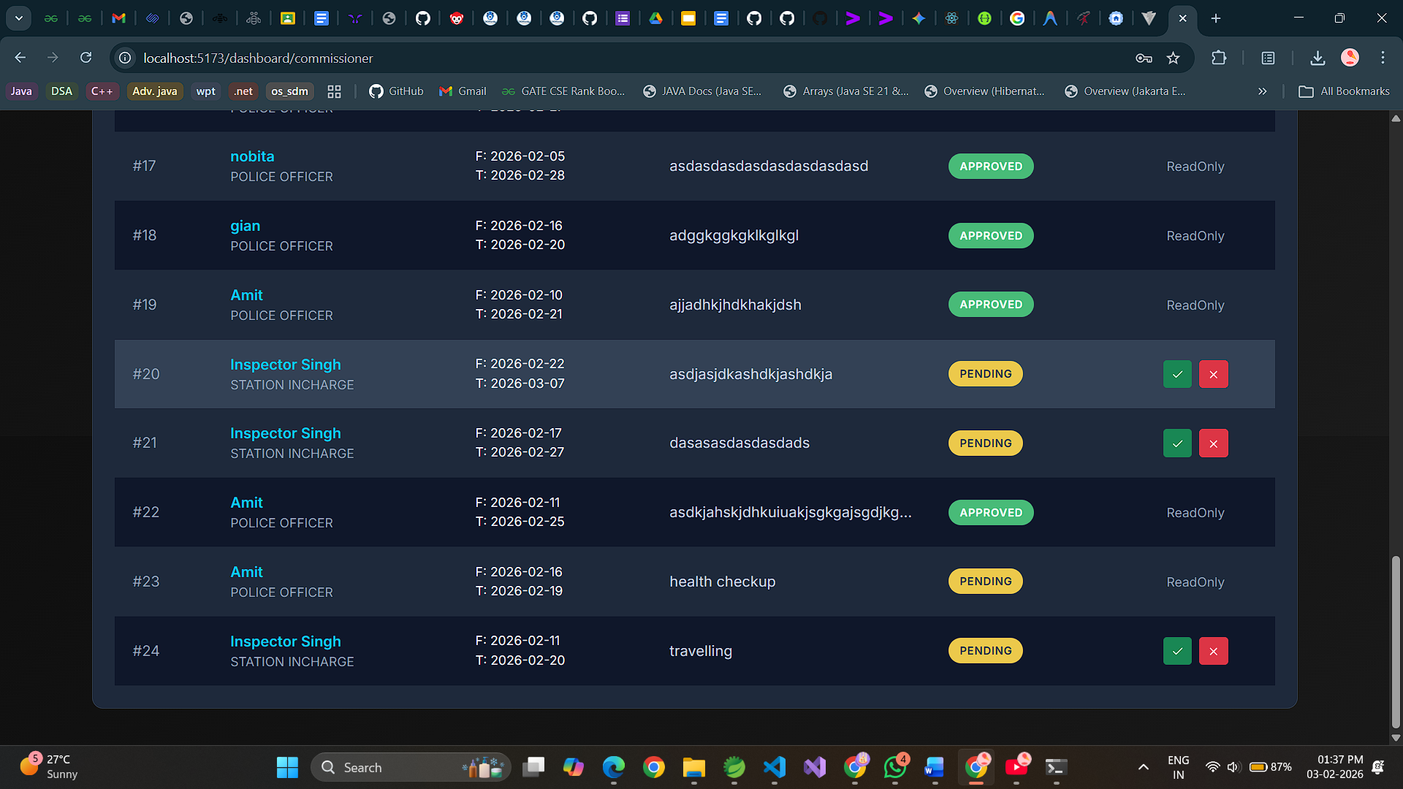

Slide 35
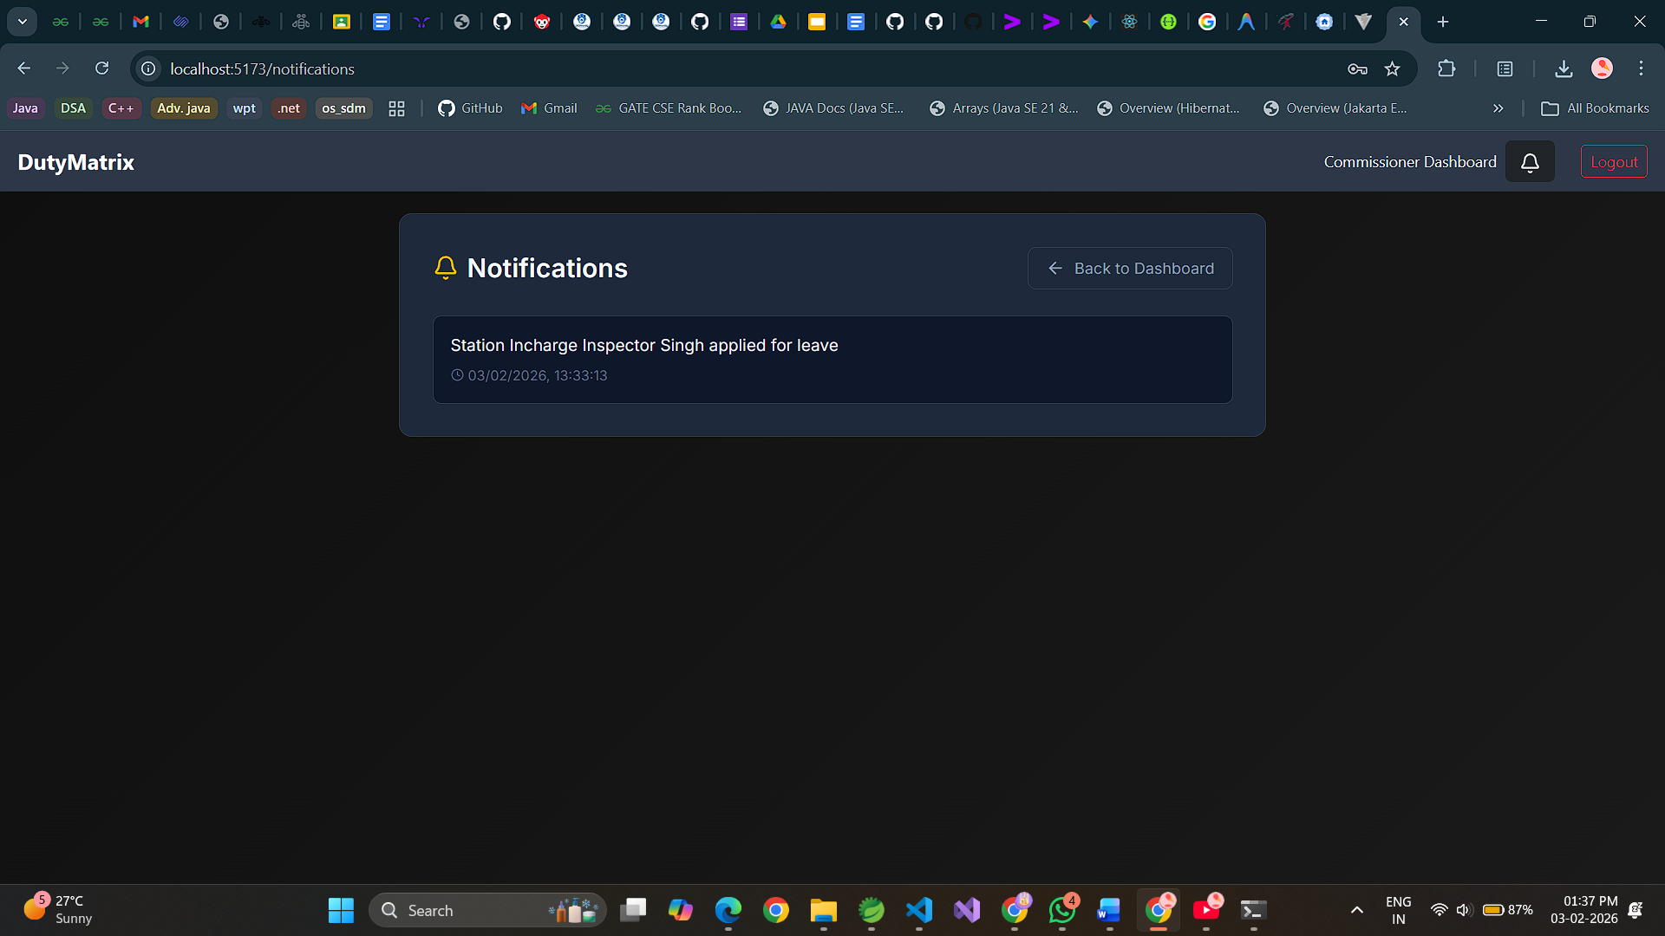

Slide 36
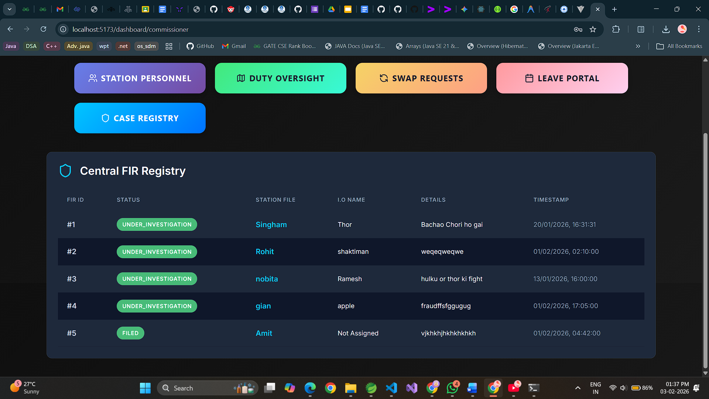

Slide 37
Thank You

